Slide 1

AJAY KUMAR GARG ENGINEERING COLLEGE
DEPARTMENT OF ELECTRONICS AND COMMUNICATION ENGINEERING
DIGITAL CLOCK (MINI PROJECT)
Student Name - Ankit Kumar Yadav Dr. Deepak Yadav
Roll No. 2300270310039 Assistant Professor
ECE - 1

Slide 2
CONTENT
  Introduction
  Component
  Digital Clock
  Reference

Slide 3
INTRODUCTION
  In today's digital age, accurate timekeeping is crucial in various aspects of daily life, from scheduling activities to managing workflows.
  A digital clock is an essential electronic device that displays the current time in hours, minutes, and seconds using digital technology.
  This project aims to design and simulate a digital clock using Multisim software, providing a hands-on experience with electronic components and circuit design.

Slide 4
component
Decimal Counter
0 to 9
Decimal Counter
0 to 99
Decimal Counter
0 to 59
Decimal Counter
1 to 12
Logic Gates
AND Gate
OR Gate
NAND Gate

Slide 5
HISTORY OF MULTISIM
  Multisim was originally called Electronics Workbench and created by a company called Interactive Image Technologies
  At the time it was mainly used as an educational tool to teach electronics technician and electronics engineering programs in colleges and universities.
  National Instruments has maintained this educational legacy, with a specific version of Multisim with features developed for teaching electronics.

Slide 6
  In 1999, Multisim was integrated with Ultiboard after the original company merged with Ultimate Technology, a PCB layout software company.
  In 2005, Interactive Image Technologies was acquired by National Instruments Electronics Workbench Group and Multisim was renamed to NI Multisim.

Slide 7
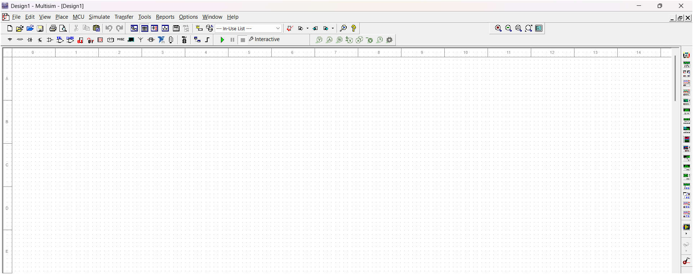
MULTISIM SIMULATION
This Area is called Workspace

Slide 8
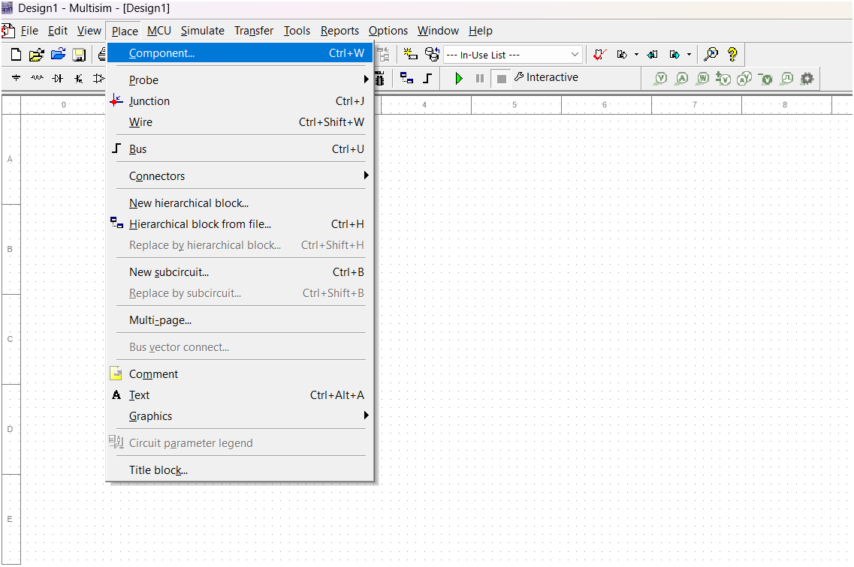
Component Selector

Slide 9
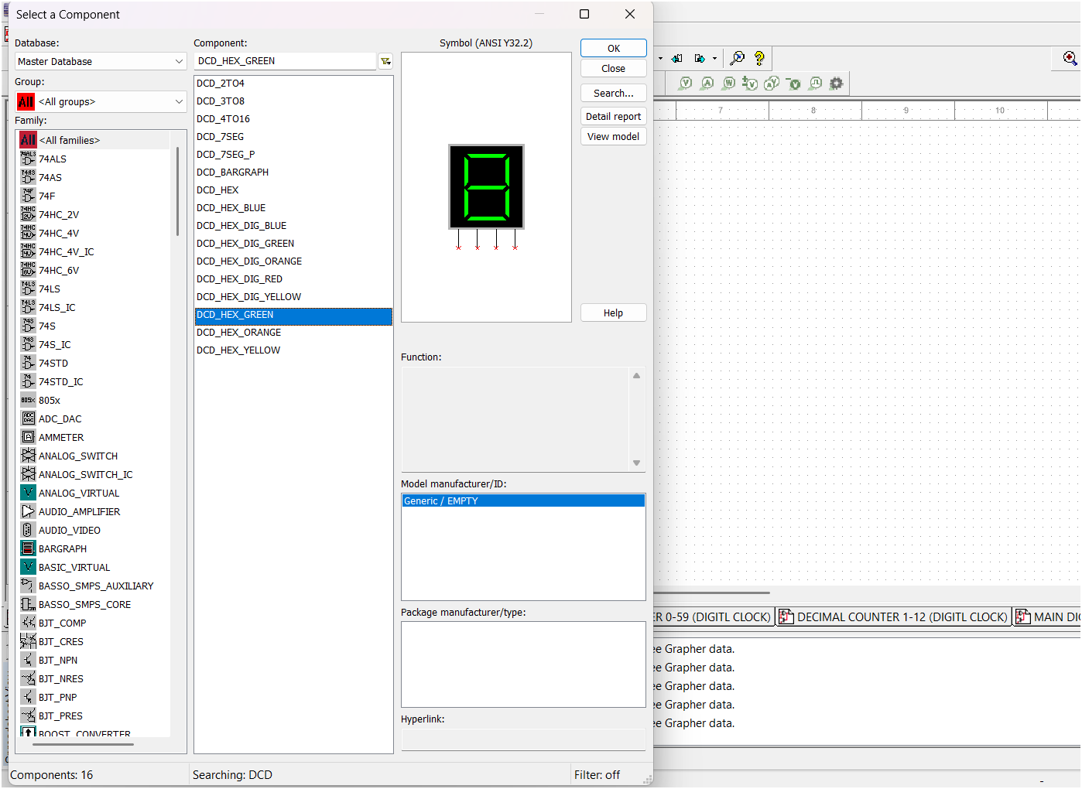
This Component Name is DCD_HEX_GREEN

Slide 10
Decimal counter 0 to 9
  For the decimal counter 0 to 9 , we used 74LS76 which is IC of Synchronous UP counter JK Flip Flop.
  In 74LS76 have 16 pins.
  But it has four main inputs:
  (1) J: The J input controls the next state of the flip-flop. When J is high, the flip-flop will toggle its state.
  (2) K: The K input controls the next state of the flip-flop. When K is high, the flip-flop will go to the 1 state.
  (3) Clock: The clock input determines when the flip-flop will change its state. The flip-flop will change its state on the positive edge
  of the clock signal.
  (4) Reset: The reset input can use to reset the flip-flop to the 0 state.

Slide 11
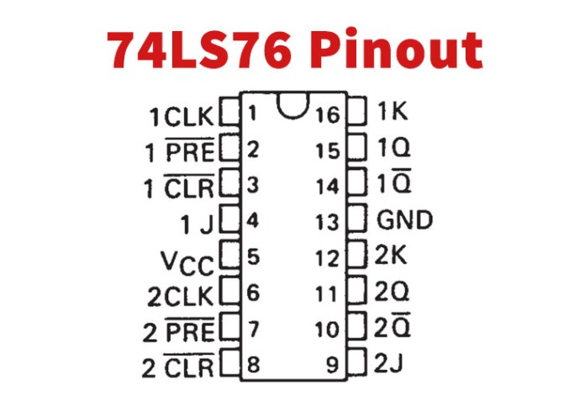
PINS | DETAILS
CLK | It is used to give the clock pulse to the first JK flip flop.
PRE | It is used to make the output (1Q) of first flip flop HIGH.
3 CLR | It is used to reset the output of first flip flop.
4 INPUT 1 | It is used to give the first input data bit to the IC.
VCC | It is used to power up the IC to make it functional.
CLK | It is used to give clock pulse to clock of the second JK flip flop.
PRE | It is used to make the output (2Q) of second flip flop HIGH.
CLR | It is used to reset the output of second flip flop.
9 INPUT 2 | It is used to give the first input data bit to the IC.
10 2Q’ | Pin 10 is the second output pin of the second flip flop.
11 2Q | It will give the output bit of the second flip flop.
12 INPUT 2K | It is used to give the second input data bit to the IC.
GND | It is used to make common ground with power supply and other devices if there’s any.
14 1Q’ | It will give the inverted output of Pin 15.
15 OUTPUT 1Q | It will give the output bit of the first flip flop.
16 Input 1K | It is used to give the second input data bit to the IC.

Slide 12
Expression for simulation which count 0 to 9 :
J(A) = 1 , K(A) = 1
(2) J(B) = AD` , J(B) = A
(3) J(C) = AB , J(B) = AB
(4) J(D) = ABC , J(D) = A

Slide 13
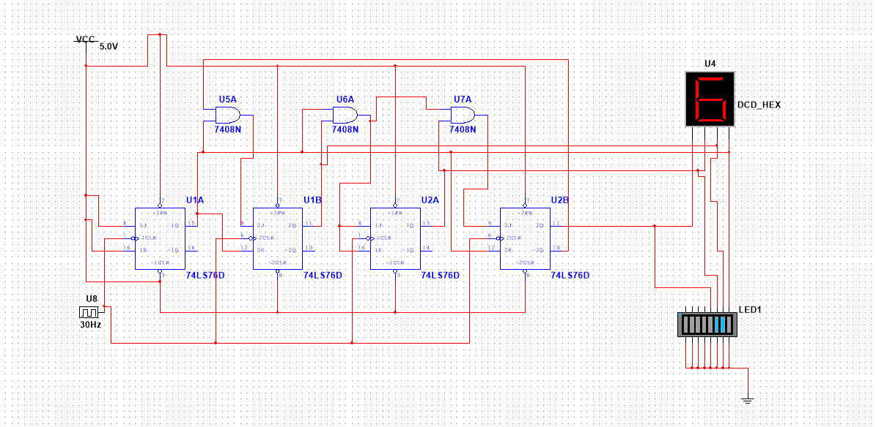
Figure – 1 Decimal Counter 0 to 9

Slide 14
Decimal counter 0 to 99
  For the decimal counter 0 to 99 , we used two 74LS76 which is IC of Synchronous UP counter JK Flip Flop.
  Here we used also two DCD-HEX for the display the number from 0 to 99 and here we used total 8 IC of JK Flip Flop.
  We can see the figure in the below slide:

Slide 15
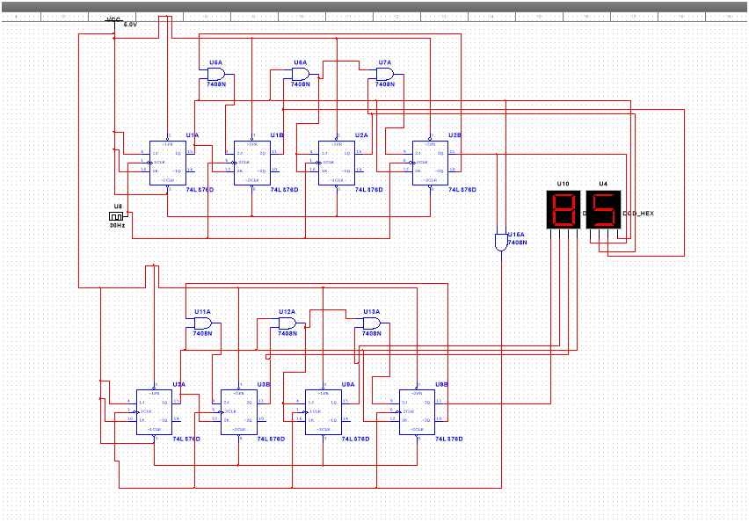
Figure – 2 Decimal counter 0 to 99

Slide 16
Decimal counter 0 to 59
  For the decimal counter 0 to 59 , we used two 74LS76 which is IC of Synchronous UP counter JK Flip Flop.
  Here we used also two DCD-HEX for the display the number from 0 to 59.
  For the counting 0 to 59 , we do not connect the one input pin of the hex display and here we also used seven IC of the JK Flip Flop.
  We can see the figure in the below slide:

Slide 17
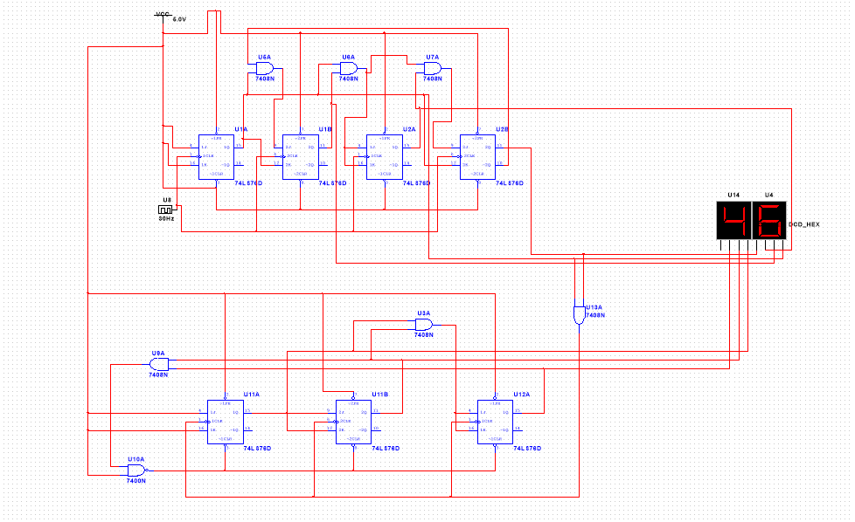
Figure – 3 Decimal counter 0 to 59

Slide 18
Decimal counter 1 to 12
  For the decimal counter 1 to 12 , we used two 74LS76 which is IC of Synchronous UP counter JK Flip Flop.
  Here we used also two DCD-HEX for the display the number from 1 to 12.
  For the counting 1 to 12 , we do not connect the 3-input pin of the hex display and here we also used the total five IC of the JK Flip Flop.
  We can see the figure in the below slide:

Slide 19
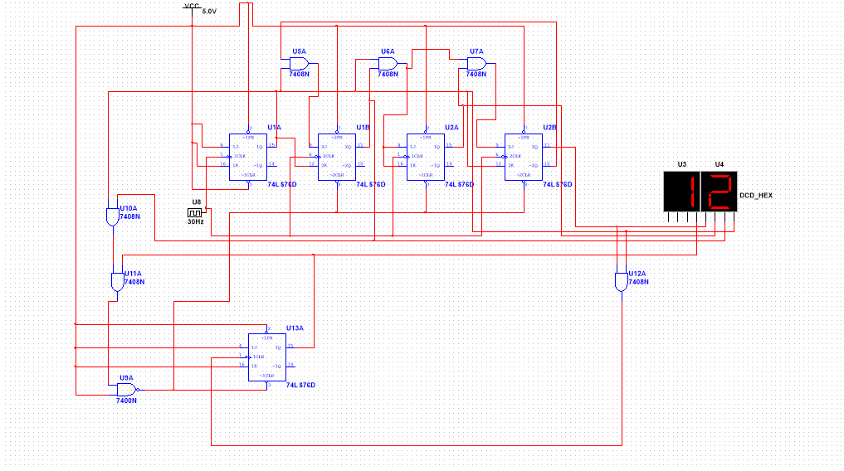
Figure – 4 Decimal counter 1 to 12

Slide 20
Digital clock in Multisim
  Digital Clock Project in Multisim:
  Multisim is a powerful electronics simulation software that can be used to design and simulate a digital clock circuit.
  Here's a basic approach to creating a digital clock project in Multisim:

Slide 21
Core components:
  Clock Source: You'll need a stable clock signal. Multisim provides various options, such as a function generator set to a specific frequency (e.g., 1 Hz for a 1-second pulse).
  Counters: Use digital counters (e.g., 74LS90) to count the clock pulses and keep track of seconds, minutes, and hours.
  Decoder/Driver: A decoder/driver circuit (e.g., 74LS47) will translate the binary output of the counters into signals to drive the display.
  Display: You can use virtual 7-segment displays or other display components available in Multisim's library.

Slide 22
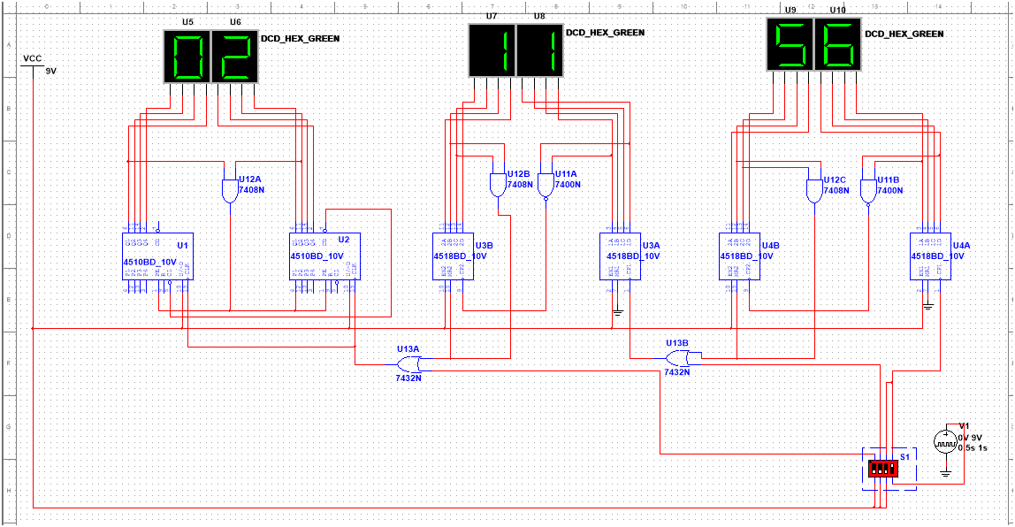
Figure – 5 Final Digital Clock

Slide 23
reference
  https://youtu.be/pHuCuHsOnls?si=zbmj0JYcOSvWJt_B
  https://youtu.be/6eD8-O9kC6I?si=saR1GR6lsDq9K782

Slide 24
THANK YOU

